Slide 1
National Financial Education Strategies Best practices and next steps
Edlira Dashi
Financial Sector Specialist

Slide 2
National Financial Education Strategies
Financial education is a core component of financial empowerment for individuals and the stability of the financial system
In 2016, the leaders of the G20 endorsed the National Strategies for Financial Education (NFES), developed by the OECD and International Gateway for Financial Education.
Roughly 100 countries have adopted or are actively drafting a NFES.
The World Bank has provided inputs to the Bank of Albania on the NFES development in the context of the Remittances and Payments Program, funded by SECO.

Slide 3
Many Different Approaches…
A SINGLE INSTITUTION
(most common) leads the strategy drafting process, as well as the overall coordination, monitoring and evaluation. This can be done with the help of donors, working groups and broader consultations to solicit other stakeholder inputs
A MULTI-INSTITUTIONAL APPROACH
where multiple institutions may share accountability and draft the NFES together (either with or without support of a donor or third-party consultant). WGs and broader stakeholder consultations still apply.
INTERAGENCY COMMITTEE
is constituted under the leadership of a single institution but tasked to design, develop and launch an NFES. This approach is generally implemented in countries where regulatory authority is dispersed across multiple institutions within the financial sector
STAND-ALONE STRATEGY
This is a strategy that outlines steps, roles and responsibilities for the design, implementation and evaluation of a National Financial Education Strategy (NFES).
HYBRID OR INTEGRATED STRATEGY
Financial education is often a pillar or key component or objective of a country’s National Financial Inclusion Strategy (NFIS) or any relevant national strategy.
STAND-ALONE PROGRAM
This is often a precursor of a NFES. It might outline an approach for reaching various target groups but does not contain other components such as a coordinating body or monitoring and evaluation (M&E) system.

Slide 4
NFES Leadership & Coordination
Central Bank is lead entity in 37%
(e.g., Nigeria, Pakistan)
Ministry of Finance or other ministry is lead entity in 40%
(e.g., Peru, Indonesia)
Other financial sector regulatory authority is lead entity in 3%
(e.g., S. Korea)
A multi-stakeholder entity leads in 20%
(e.g., Mexico, Kyrgyz Republic)
Notes:
Among 34 countries with an active NFES:

Slide 5
Financial Education Mandates

Slide 6
Illustrative Roles of Stakeholders

Slide 7
Financial Education is a challenging undertaking
Cumbersome data collection
Broad scope
Resource-intensive
High cost
Notes:
Emerging evidence suggests that key behavioral tools and practices, such as simplifying financial education into concrete, actionable steps, personalizing education, providing short, timely messages, and making education convenient and easy to access, have successfully changed consumer knowledge, decision-making, and financial behaviors.
available resources and complements existing knowledge about financial education.

Slide 8
Building blocks of an effective NFES
Governance & Coordination
Strong central leadership body
Programmatic scope
Programs built on good practices
Well-defined action plan
Clear, concrete, prioritized objective
Prioritization to focus on high-priority, high-impact actions
Focus on digital approaches, including flexibility to adapt action plan to reflect market developments
“Quick wins” to build momentum following launch
Strong buy-in from start
Partnerships: private, public, NGO
High-level “champions” within each implementing institution
Assessment
Mapping of existing initiatives
Robust diagnostics and data to provide analytical foundation
National financial capability survey for benchmarking
Balance between inclusive and efficient governance structure
Management
Roadmap and ideas for funding
Mobilization of resources for implementation prior to launch
Effective communication / branding of the NFES
Well-resourced and robust monitoring and evaluation system

Slide 9
Key pillars of developing institutional action plans

Slide 10
STEP 1: Assess the Landscape
Take stock of best practices
1
Gather insights from related stakeholders, such as market conduct and consumer-protection supervisors,
2
Focus on points of interaction between consumers, FSPs, and government financial programs
3
Gather the perspectives of the various stakeholders
4
Leverage various data collection means (desk research, customer journey mapping, consumer profiling, stakeholder interviews, phone surveys, etc.)

Slide 11
STEP 2: Identify and Prioritize Areas of Consumer Risk
Identify immediate needs from the perspective of different types of consumers as well as core gaps across different product lines during key interactions between consumers and their FSPs or financial programs.
1
Detect emerging areas of consumer risks that warrant priority as well as core education gaps and needs of different consumer profiles.
2
Identify opportunity areas where core financial education messages can be integrated to help consumers navigate their financial lives.
3
Prioritize based on assessing trade-offs between lower-hanging fruits, their capacity and resources, and existing consumer risks with greatest implications on inclusion/stability.
4

Slide 12
STEP 3: Build an Effective Framework
Partner with key institutions to embed financial education into existing financial programs.
1
Provide guidance to regulated entities.
2
Offer financial education tools to the public.
3
Develop a cross-cutting monitoring and evaluation (M&E) framework.
4
Notes:
Partnerships with key institutions to embed financial education into existing financial programs. Financial sector authorities should build partnerships to support key institutions to embed financial educa- tion into programs offering financial services at scale (that is, cash-transfer programs, agricultural lending programs, and so on). Priority partners are often other government institutions (that is, the ministry of agricul- ture, ministry for social protection, and so forth), and financial sector authorities can play a key role in help- ing them integrate financial education into the design of their large-scale financial-service program.
Guidance to regulated entities. Financial sector authorities are well placed to provide guidance to FSPs (generally nonbinding) that can help encourage providers to integrate financial education holistically11 into their day-to-day operations and interactions with consumers.
Financial education tools offered to the public. Financial sector authorities often play a role develop- ing a set of publicly available resources (generally web based) provided to consumers and practitioners.12 The resources focus on addressing those core educational needs under their remit and mandate that have impli- cations on inclusion and stability. This often requires coordination with stakeholders beyond government institutions and FSPs, including with nongovernmen- tal organizations, industry associations, and consumer associations, both to support integration of priorities into their existing financial education activities and to elevate the collective consumer voice to define edu- cational needs.
Cross-cutting monitoring and evaluation (M&E). A practical M&E framework that tracks progress, mon- itors resource allocation, helps pilot new initiatives, and, to the extent feasible, measures impacts, is a cross-cutting principle to apply across all three finan- cial education action areas.

Slide 13
Best practices for programs/activities design

Slide 14
Leverage behavioral design
Leverage teachable moments
Reinforce messages
Use nudges
Automation
Make it fun and entertaining
Notes:
Leverage teachable moments.
Consumers tend to be more receptive to new information around critical finan- cial and life events, such as receiving a cash transfer from the government, opening an account for the first time, or taking out a loan. Such moments can be leveraged to provide financial knowledge, since individuals during those moments are more likely to adopt behavioral changes. Leveraging teachable moments (that is, the opportunity for the right financial education to help a consumer fully understand the implications of their prod- ucts and services before making a financial decision) is an effective strategy to connect real-life decision-making with financial education and helps to ensure that infor- mation is more likely to be retained, used, and can influ- ence cash management behaviors.
Reinforce messages.
Evidence suggests that a one-off intervention or message is less likely to bring about behav- ioral change, and that a periodic reiteration of messages should be built into financial education programming. Recurring financial-knowledge messages and reminders through such cost-effective modalities as SMS are some of the most effective options to nudge consumers toward better financial decisions. (See an example from Colom- bia in box 22.) Incorporating financial education messages and behavioral nudges into people’s daily life helps them develop healthy financial habits in a natural way. For instance, mobile-network operators can be leveraged to provide mass messaging of core financial education con- cepts, messages, or reminders. Cash-transfer recipients may receive SMS educational reminders, or perhaps sav- ing messages may be targeted toward adults enrolled in savings schemes.
Use nudges:
Global evidence has shown that simple nudges such as messaging can sometimes overcome limited attention issues that often result in an inability, for instance, to stick to a budget or savings plan. For messaging to be an effective tool, the content, timing, and platform must be right. Messages can either encour- age or discourage a particular behavior. Encouraging messages aim to develop a positive savings habit.91 Effective nudges are also personalized. For instance, messages that include a consumer’s specific objective are more effective than a generic message.92 Reminding customers that their peers have saved 20 percent more in a particular month than they have can motivate cus- tomers to save more. Lastly, it can be effective to provide information that makes it psychologically difficult to con- duct a bad financial habit—for instance, exploiting social pressures to discourage bad habits.
Automation:
Automation has also proved to be extremely effective, particularly for low-income consumers. For example, individuals have a tendency not to enroll in automatic deductions to build savings today but may be more open to the idea in the future. Offering them the option for future automation commits them to saving in the future. This is shown to be surprisingly effective; one of the most successful savings interventions employs the same method.
Make it fun and entertaining:
As much as possible, financial capability initiatives should be fun, entertaining, and interactive and use simple messages that will reso- nate with the target audience. Especially for children and youth, entertainment can be a powerful means to increase financial literacy and form healthy financial habits. (See box 23.) Where practical, the initiatives should involve learning by doing.

Slide 15
Address the Needs of Women and Vulnerable Populations
Ensure that women and other minorities are well represented in key leadership and decision-making roles across the financial education space.
Encourage FSPs to hire with more intentionality a representative staff, including more female and minority staff and female and minority management.
To inform programmatic design, collect adequate data to understand different profiles of consumers and their needs.
Ensure that consumer voices are well heard, including the voice of associations that work to represent women or minorities specifically.
Include representatives from all target groups in consultations and training staff.
Identify optimal times for training that work better with the schedules of women or other vulnerable consumers.
Avoid referring in content and training to gendered behaviors or stereotypes that affect marginalized consumers, as otherwise it may reinforce false perceptions of different population groups.
Advocate for and include scenarios in which women or other marginalized consumers take active roles in financial management and decision-making.

Slide 16
Know your target groups
Financial education should be client focused and reflect the demographics, cultural and financial context, and learning needs and preferences of the target population.
Education must be relevant in the context of consumers’ financial lives and help inform them about financial decisions that can be realized in the short or medium term.
Assessment can be conducted through a variety of means, to shed light on both key financial education gaps in the market and opportunities where additional education and information can be embedded to address these gaps.

Slide 17
Use a Wide Range of Tools and Channels
Nontraditional channels (that is, chatbots, SMS messages, tablets, phone applications, and so forth).
key messages and simulations may be useful during program onboarding, while nudges via SMS and default savings options may encourage customers to use or save as part of the program.
Big data can be leveraged to provide customer support and education by, for instance, helping customers navigate information-dense product offerings or incorporating robo-advice on how to meet savings targets.
A variety of channels and delivery platforms such as nudges, reminders, and choice architecture.

Slide 18
Learn by Doing
Practicing is particularly important for digital finance, as it helps consumers master their financial knowledge and skills and improves their familiarity and confidence when conducting digital transactions.
Providing tutorials for innovative products helps build consumer confidence through hands-on learning. This may include offering demonstrations of technology-driven products and delivery channels.
Incorporating simulations helps consumers practice using new technologies and testing key functions. This approach could also be helpful in cases where consumers are not literate enough to read written instructions.
Delivering financial education as part of consumers’ digital-payment product may holistically strengthen their familiarity with digital products and service

Slide 19
Mistakes to avoid
Using a single delivery mechanism as opposed to employing a range of channels
Making assumptions on the numeracy and literacy levels of beneficiaries, including conceptual assumptions on understanding of money or savings.
Rushing to integrate various delivery channels without assessing the levels of accessibility and feasibility of each channel.
Delivering lessons during times that do not leverage relevant, teachable moments or relate to applicable experiences for the beneficiary.
Including messages which market initiatives for financial products, services or providers.
Building one-time lessons or programs, without repeating and reinforcing messages throughout the cash transfer program.
Reinventing the wheel and dismissing lessons learned from successful financial education programs already undertaken in the country.
Using lecture-based curricula which can become boring or unengaging

Slide 20
Thank you!

Slide 21
KEY RESOURCES

Slide 22
Key Resources
SOURCE | RESOURCE
World Bank | Good Practices for Financial Consumer Protection Integrating Financial Capability into Government Cash Transfer Programs Financial education Programs and Strategies: Approaches and Available Resources Making Sense of Financial Capability Surveys around the World Financial Capability in Low- and Middle-Income Countries: Measurement and Evaluation Enhancing Financial Capability and Behavior in Low- and Middle-Income Countries Consumer Risks in Fintech—New Manifestations of Consumer Risks and Emerging Regulatory Approaches
CGAP88 | Elevating the Collective Consumer Voice in Financial Regulation
OECD/INFE | Smarter Financial Education: Key Lessons from Behavioural Insights for Financial Literacy Initiatives The Application of Behavioural Insights to Financial Literacy and Investor Education Programmes and Initiatives National Strategies for Financial Capability: OECD/INFE Policy Handbook OECD/INFE High-Level Principles on National Strategies for Financial Education G20/OECD Core Competencies Framework on Financial Literacy for Adults OECD/INFE Core Competencies Framework on Financial Literacy for Youth OECD/INFE Report on Financial Education in APEC Economies: Policy and Practice in a Digital World
Microfinance Opportunities | Taking Stock: Financial Education Initiatives for the Poor
Center for Financial Inclusion/Accion | A Fourth Era: Balancing Behavioral Interventions with Quality Education Seven behaviorally informed practices for effective financial capability interventions Delivering Financial Capability: A Look at Business Approaches A Change in Behavior: Catalogue of Innovations in Financial Capability
Innovations for Poverty Action | Beyond the Classroom: Evidence on New Directions in Financial Education
AFI Global | The Financial Competency Matrix for Adults: A Policy Framework Financial Education in Latin America and the Caribbean
Toronto Center | How Supervisors Can Improve the Effectiveness of Financial Education

Slide 23
Overview of Rigorous Financial Education Impact and Meta-Analysis:
SOURCE | RESOURCE
World Bank | Financial Education Programs and Strategies Can You Help Someone Become Financially Capable?: A Meta-Analysis of the Literature Does Financial Education Impact Financial Literacy and Financial Behavior, and If So, When?
CFI | A Fourth Era: Balancing Behavioral Interventions with Quality Education
IPA | Beyond the Classroom: Evidence on New Directions in Financial Education
Management Science | Financial Literacy, Financial Education, and Downstream Financial Behaviors
GFLEC | Financial Education Affects Financial Knowledge and Downstream Behaviors

Slide 24
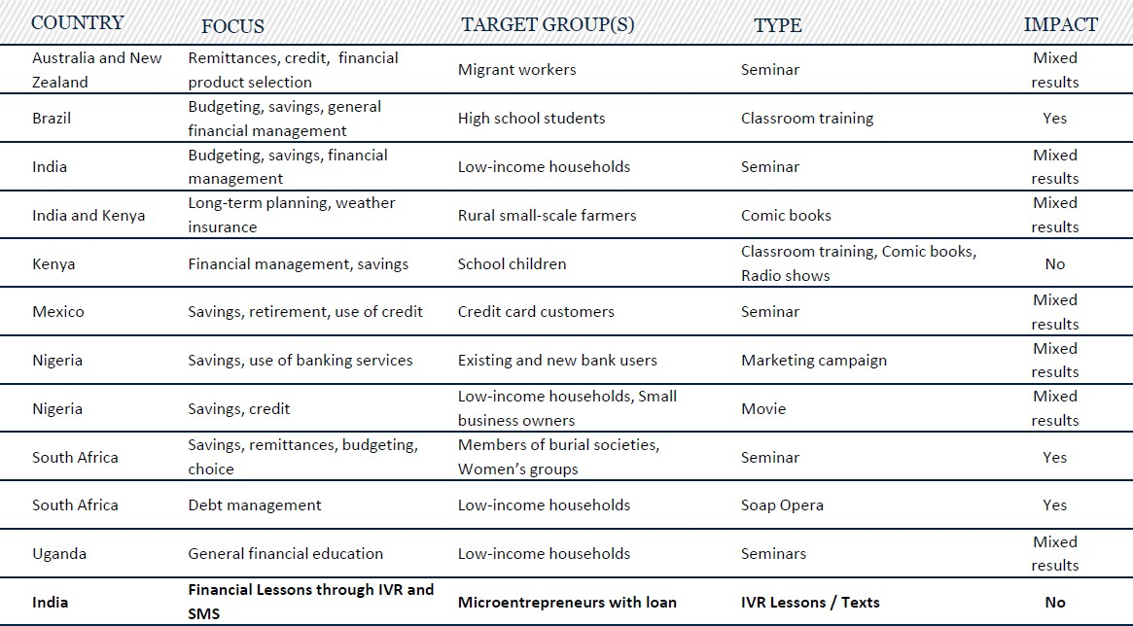
What Works in Financial Education

Slide 25
Examples of Financial education platforms
REGULATORY AUTHORITY | WEB-BASED FINANCIAL EDUCATION TOOLS
Australian Securities and Investments Commission | The MoneySmart website includes financial education information on topics such as money management, debt reduction, and investments. The site also includes online calculators and tools.
United States Consumer Finance Protection Bureau (CFPB) | The CFPB’s website offers a set of consumer tools, with information on easy-to-recognize terms and topics, such as auto loans, debt collection, credit cards, and bank accounts and services, through which consumers can access practical information needed in that particular teachable moment. The CFPB’s website also includes resources for educators to help them develop and deliver financial education content themselves. The resources are categorized for different population segments, such as adults, youth, or vulnerable consumers.
United Kingdom’s Money Advice Service | The Money Advice Service is a website tailored to consumers’ practical needs and divides information into different money topics in which a consumer might be interested, such as debt and borrowing or cars and travel. Based on the need, a consumer can access a dropdown menu of information and tools that will inform their decision about, for example, buying a car.
Banque de France | The Banque de France, French Prudential Supervision and Resolution Authority, and Autorité des marchés financiers have a joint dedicated website that provides practical information on banking products, insurance, and financial investments; provides guidance to consumers before the completion of a transaction or in case of a complaint; helps the public to protect themselves from scams; provides alerts on unauthorized practices, actors, or websites; and collects information or complaints that customers wish to bring to the attention of the authorities.
South African Financial Sector Conduct Authority (FSCA) | The FSCA’s consumer education department manages a website that presents educational material on topics such as money management, financial protection, and investments.
Bank of Italy | The Bank of Italy’s website provides a series of services to consumers, including access to credit register data and lists of registered financial providers and products. A special portal called Economics for Everyone summarizes the full range of Bank of Italy’s financial education programming, including initiatives for children, adults, schools, and universities. The portal provides news, videos, calculators, games, and infographics, among other useful tools for everyday choices, including online purchases, opening a current account, managing the family budget, and applying for a loan.
Banco de Portugal | The Central Bank of Portugal has been promoting financial awareness and financial education through a series of interventions, including a dedicated website (the Banking Customer Portal) that contains information on all key banking products and services in Portugal and various related resources, such as a glossary of financial terms and answers to frequently asked questions. A special focus of Banco de Portugal’s financial education activities has been youth.
Central Bank of Bosnia and Herzegovina | The Central Bank of Bosnia and Herzegovina developed a financial education web portal that provides content and guidance for consumers and providers. The portal provides in-depth information on key financial services related to capital markets, leasing, and factoring, and the topics were chosen as priority topics to help build consumers’ knowledge of how these financial services work in practice.
Financial Consumer Agency of Canada | The Canadian Financial Literacy Database offers tools to help individuals identify areas where they could broaden their financial knowledge and skills (through a self-assessment quiz) and then directs them a database of specific resources or events that can help them improve or maintain their financial skills and knowledge. The resources in the database can be searched by topic, population segment, location, or knowledge level. The database also offers a list of financial-literacy events across the country, funding programs that support financial-literacy initiatives, and published research and reports

Slide 26
Examples of Financial Education Platforms
PLATFORM TYPE | DESCRIPTION | INNOVATIVE PLATFORMS
MOBILE-BASED PLATFORMS | Using mobile platforms to deliver financial capability through (i) SMS messaging and reminder systems; (ii) voice calling and voice- mails; and (iii) application-based programs. | JUNTOS uses SMS messaging for reminders and automated conversation based on machine learning technologies to build trust and capability for customers; Banamex uses texts and calls to provide capability elements to beneficiaries.
SOCIAL/ LOCAL CONNECTIONS | Leveraging social relationships, key community leaders, or local government authorities to deliver or reinforce key capability messages. Uses informal or formal touch points (like clubs or associations) to provide trainings and trainers. | HERfinancec leverages social interactions to pass along trainings and financial information to other women through workplace-based financial education sessions.
MASS MEDIA / ENTERTAINMENT | Using TV shows, posters, radio shows, movies, commercials, comics, and so on to provide financial capability concepts. | Nigeria Nollywood Nudge, Makutano Junction, and Scandal all embedded financial capability concepts and themes through videos and soap operas.
CURRICULUM BASED | Embedding financial capability and literacy pro- grams into available education modules, curri- culums, or training. Can use, for instance, schools as a platform to deliver workshops or events. | BANSEFI Mexico provides face-to-face financial capability trainings provided by core program staff before providing cash transfers to recipients.
TABLETS / PROGRAMMED APPLICATIONS | Embedding financial capability training into tablets or other application-based programs (often self-paced) | LISTAd Colombia designed self-paced financial capability modules delivered to CCT recipient villages through tablets. A community organizer provides and rotates the tablets between households, where CCT recipients go through the courses at their own pace.
ONLINE AND INTERNET BASED | Use of online or internet-based websites as either (i) freestanding websites for counseling or advice or (ii) complementary tools by providers. | Mexico’s Consumer Protection Agency CONDUSEF developed a government-led financial literacy and transparency website (and magazine) to promote financial capability

Slide 27
ANNEX

Slide 28
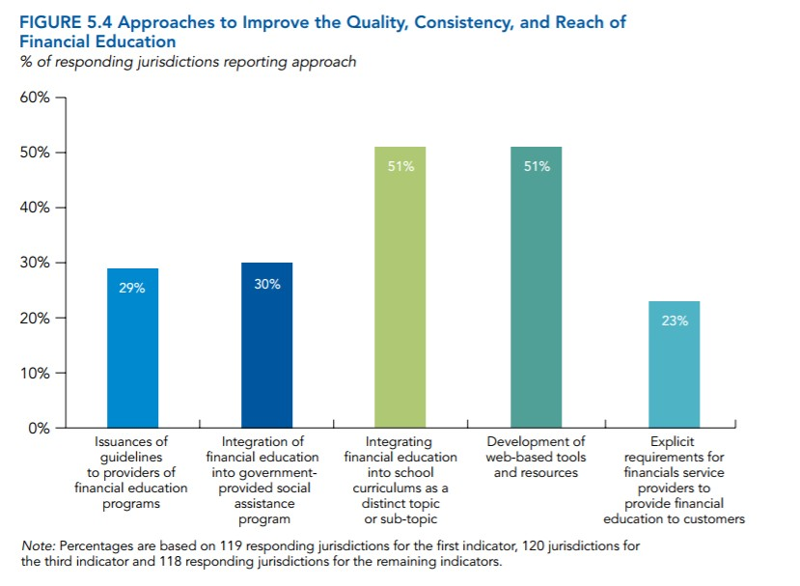
Action Plan Common Country Approaches to Improve Financial Education

Slide 29
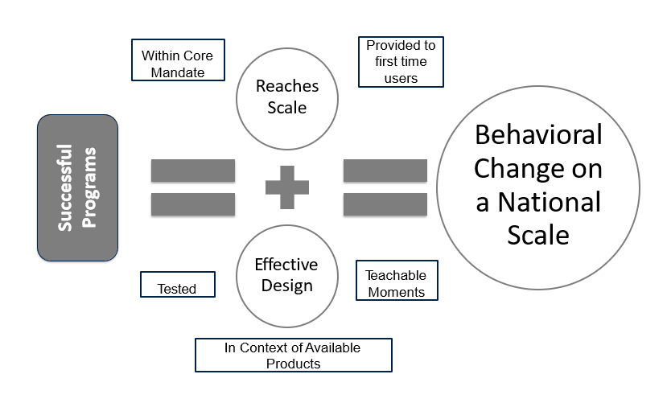
How to design your action plan?

Slide 30
Development of Programs: Good practices
Built on solid and wide-ranging research (or needs assessment)
Targeted and relevant design and delivery
Accessibility of content and delivery
Timely interventions (“teachable moments”)
Engaging format and interactive delivery (dialogue, media, games, mobile tech, etc.)
Leverage existing social networks
Provide unbiased information on services (not simply “marketing”)
Provide opportunities for “learning by doing”
Incorporate nudges and reinforcement – not just a “one-off”
Cost-effective and scalable
Builds in monitoring to ensure quality

Slide 31
Effective Design: Key Considerations for Program Design and Delivery
Remain within core mandate
Provide financial education during “teachable moments”
Reflect the context of financial services actually available to recipients
Cost and resource effective
Reinforce education and key messages periodically, through the active engagement of participants over time

Slide 32
Effective Design: Key Considerations for Program Delivery
Use a wide range of instruments, particularly for illiterate beneficiaries
Build on the existing evidence base of effective programs
Simulate and provide demonstrations of the technology or product first, particularly if using tablets, smartphones, or feature phones
SMS messaging for core concepts or reminders to those with existing context

